Slide 1
FINISH!
If you want to be the best distance runner you can be, it is vital that you learn how to do one thing exceptionally well. You better learn how to FINISH!
The outcome of all distance races, whether track, cross country or on the roads, is determined by who finishes best. There is no debating this. It is a fact born out over hundreds of years and millions of runners.
Champions know how to FINISH!

Slide 2
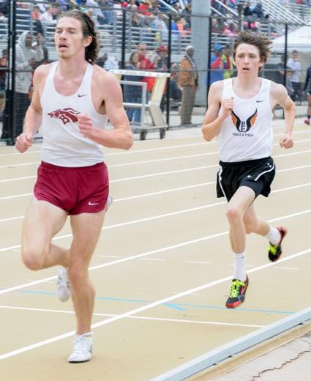
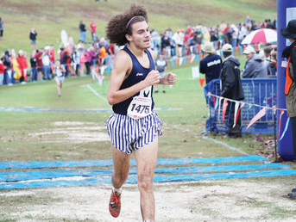
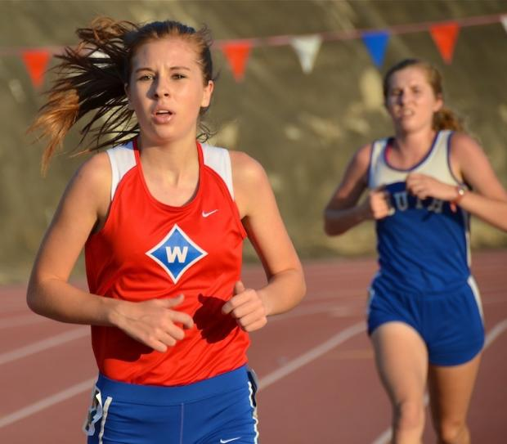
FINISH!
When Logan Poteet broke 9:00 at Tech last year in the 3,200M, Miles Yapp led nearly every step. Logan beat him at the end. One of the best high school races I’ve ever personally witnessed. 2 talented runners. Only one winner.
John Green was in the lead at the state XC meet with 4 minutes to go. Carlos Torres beat John by nearly 20 seconds. He gained 100M in the last 1000M!
In the 2nd mile of the girls 6A state 3200M, Avery Bussjager (defending state champion) passed Savannah Carnahan and started pulling away. I remarked out loud while watching the race that Carnahan was done. Carnahan repassed Bussjager - you almost never see high school runners repass late in 3200M races - and finished 2nd instead of 3rd. Boy was I wrong!

Slide 3
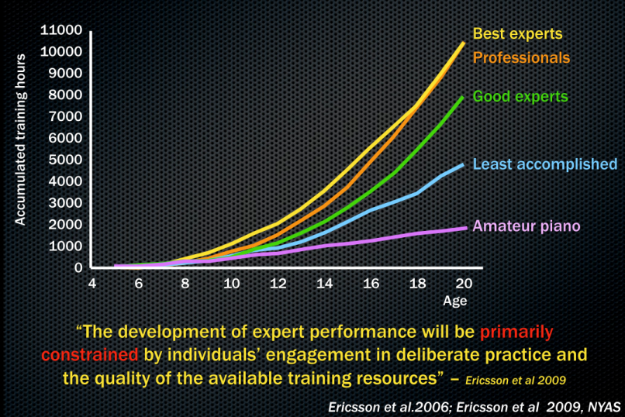
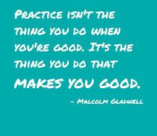
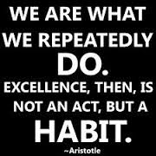
FINISH!
So, how does this happen?
How do the best athletes become so good at finishing?
Like everything else in life, the way you get good at anything is by believing it is important and then by practicing. To gain expertise and mastery at something, you can’t just practice it sometimes. It has to become an every day pursuit. Malcom Gladwell wrote a very cool book that suggests it takes 10,000 hours of practice to create mastery. So, If you want to be your best at running, you must focus on finishing every single day, in every single practice and in every single race. Excellence is a habit.

Slide 4
FINISH!
Beyond running, learning how to FINISH is an excellent life skill to seek and perfect……
Want to get accepted into a really good college? Finishing might be doing 3 more rounds of polishing on your application essay. Doing this could be the difference in getting in your dream school or settling for your 2nd or 3rd choice. Finishing is often about focused effort and hard work.
Want to pursue a career in sales? Maybe real estate? Finishing might mean learning a little something extra about your buyer’s needs and the neighborhood in the house you are trying to sell to find the key spark of common ground that helps you close the deal. Make the sale and provide for your family or worry when the bills come in? Your choice. Finishing often requires you to do a little more than the other guy.
Want to be great spouse? Finishing might mean choosing to do something your partner really wants to do rather than doing the thing you’d rather do because you know that a sacrifice in your short term wants leads to a life time loving relationship. Finishing sometimes means finding your motivation in your love for someone important to you. Now that is what I call finishing!

Slide 5
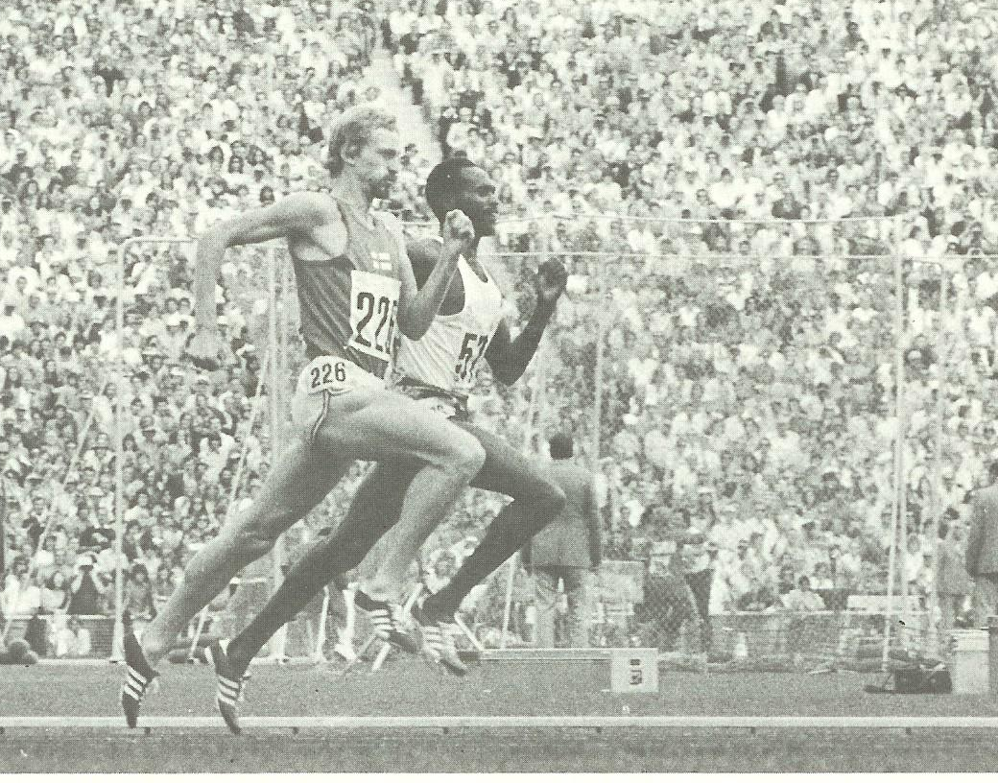
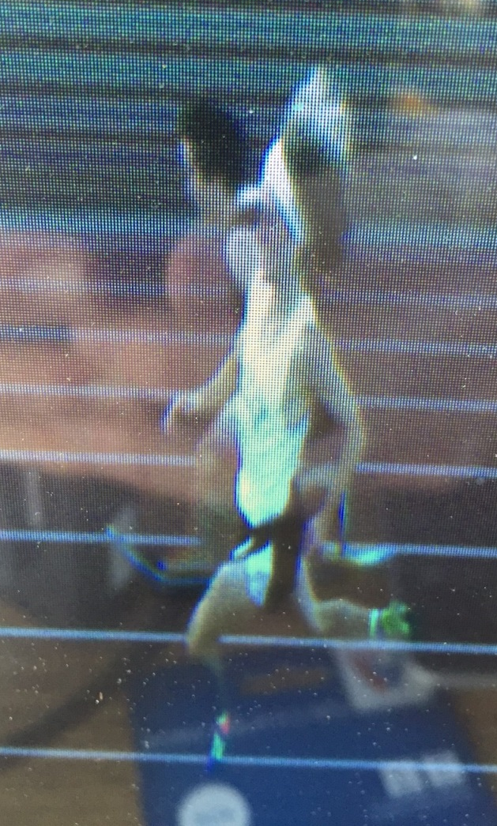
FINISH!
What does finishing look like for our track team?
Above. Perfect closing sprint form in the Olympics 1500M
At right. Region 3200M champion and runner up.
Difference? 20 milliseconds or about 1 inch!

Slide 6
FINISH WITH CARE!
FINISH – your complete workout by adding on 10 minutes of jump squats, calf raises, walking lunges, hip drills, push ups, etc.
FINISH your workout by icing when needed, bringing and eating a protein/carb snack within 30 minutes of practice to get the nutrition your body needs to rebuild and prioritizing homework to get to bed early so your body can rest and you can stay strong.
People who want to be their best take no short cuts.
They go the extra mile.
They know how to FINISH.

Slide 7
FINISH EVERY RUN!
FINISH – each easy day run with a mindset that you will remain mentally strong. Don’t slack off on the pace of long runs in the last mile when you get tired. Concentrate on improving your form, running relaxed, focusing on quick, light footfalls and raising your effort as needed to maintain pace.
Encourage your teammates to FINISH strong with you. Speak up and bring a positive vibe when it is time to FINISH. Attitude is EVERYTHING when you FINISH. No one finishes strongly with a poor attitude. Positive energy is contagious, so be an energy giver when the going gets tough. That’s how you can FINISH and also make a contribution to your teammate’s ability to FINISH.
Having an impact on someone else’s success is a great way to FINISH.

Slide 8
FINISH ON HARD DAYS!
FINISH – your speed workouts with the commitment to make your last repetition your best. Often, that means that your last rep will be your fastest. Sometimes, it just means that your last repetition won’t be your slowest. More than anything, it is about you being intentional about your effort to FINISH strong.
As much as you are teaching your body physically that is possible to FINISH strong, it is just as important that you convince your mind. Your body is capable of cashing nearly any check that your brain is brave enough to write. Your body, on the other hand, has never talked your mind into anything! The body is a machine run by the will of the mind.
Your mind and body are 100% connected at the FINISH.

Slide 9
FINISH RACES!
FINISH – your races by being competitive and pushing your boundaries. Practice being comfortable with the uncomfortable.
In a 3200M, finishing might mean being brave enough to cover a move or trying to catch someone on lap 5 or 6 or 7 when the going gets tough.
Finishing might mean moving your “kick” in the 1600M back 100M every race all season until you learn to “go” at the bell lap rather than saving up energy for a mad sprint the last 50 meters.
In the 800M, finishing might mean never giving up in the last 200M when the entire field is dying.

Slide 10
FINISH AS A TEAM!
FINISH – each day with a team breakdown. Do not lose sight, even during track season, that the best thing about sports is that you get to do them with the members of your team!
Don’t become so self-absorbed that you forget to celebrate your teammates successes and stand ready to encourage them in their disappointments. You will become better at finishing if a big part of your motivation to be your best is fueled by your desire to represent and help your team family.
Humans are soft. We will push back the boundaries of pain only so far for ourselves.
You can move mountains if you commit your best for your team.

Slide 11
COMMIT TO FINISH!
Let’s commit to pursue and embrace finishing as an every day part of the 2016 track season! Let’s use FINISH as our break down word this season and do break downs every practice as a reminder. Let’s remind each other to FINISH during our long run days. It would be great if every single athlete, in every track workout for the whole season, said out loud… FINISH!... at the start of their last repetition. We will be a better team if our athletes toe the line at races with one thought on their minds… FINISH.

Slide 12
LEARN TO FINISH!
Want to be the best you possible?
Dream of being a champion?
See value in developing a life skill that will help you for the next 70 years?
Learn how to FINISH.

